Slide 1
Differentially Private Collaborative Learning for the IoT Edge
Linshan Jiang¹ Xin Lou² Rui Tan¹ Jun Zhao¹
¹Nanyang Technological University
²Illinois at Singapore Pte Ltd
The 2nd International Workshop on Crowd Intelligence for Smart Cities:
Technology and Applications (CISC 2019), Beijing

Slide 2
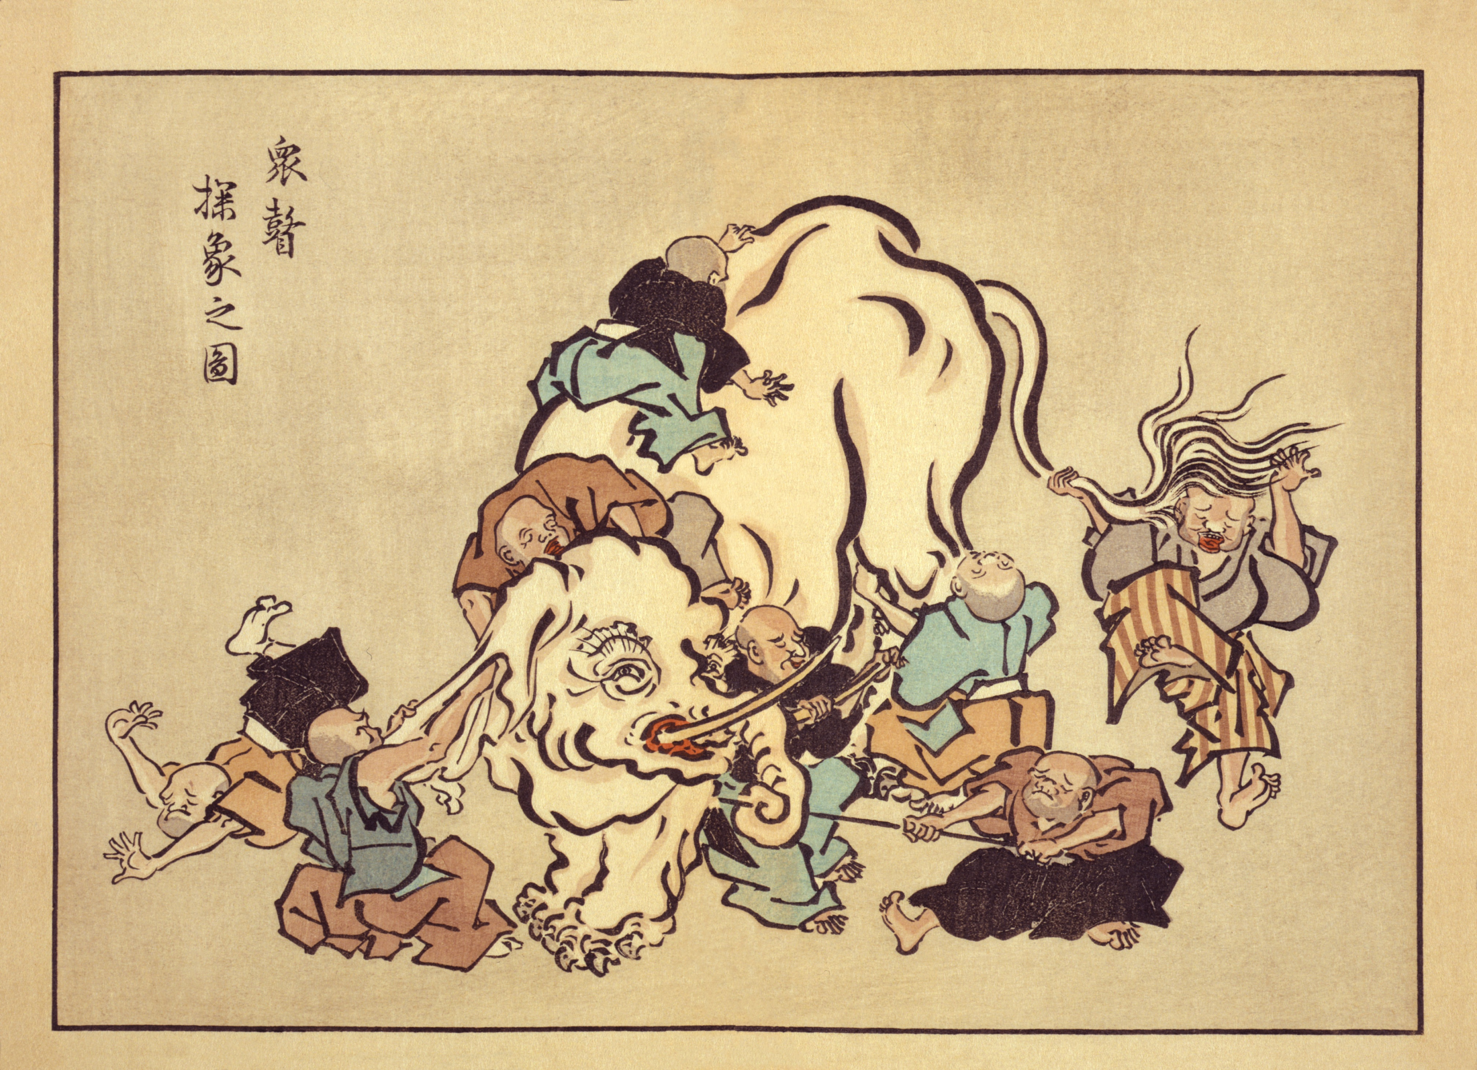
Blind Monks Appraising an Elephant
A wkiyo-e by Hanabusa Itcho (1652-1724)

Slide 3
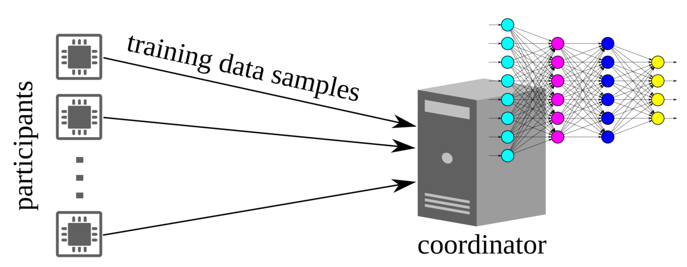
Collaborative Learning in IoT
Info for training
IoT will be a main data generation infrastructure
Each edge device observes a small portion of the process to be learned
Collaborative learning
Each participant contributes info (raw data or features) and enjoy improved machine intelligence in return
A powerful coordinator fuses info from participants for intelligence of a crowd
But, concern of privacy leak

Slide 4
Privacy-Preserving Collaborative Learning
Distributed machine learning
Crowd-ML: collaborative shallow learning [ICDCS’15]
Collaborative deep learning [CCS’15] and homomorphic encryption enhancement [TIFS’18]
Federated learning by Google [arXiv’16] and secure aggregation enhancement [CCS’17]
Drawbacks
No rigorous definition of privacy or
Cryptographic primitives incur high computation complexity

Slide 5
Privacy-Preserving Collaborative Learning (cont’d)
Training data encryption/obfuscation
Homomorphic encryption on training and testing data, Microsoft [ICISC’12] Too compute-intensive for edge devices
Random Gaussian projection [TKDE’06, Computer Networks’18] Only considers a single node, vulnerable to collusion
Random Gaussian projection [SenSys’12] Only applicable to distance-based shallow learning, a clear privacy vulnerability*
* L. Jiang, R. Tan, X. Lou, and G. Lin. On Lightweight Privacy-Preserving Collaborative Learning for Internet-of-Things Objects. IoTDI’19.

Slide 6
Other Related Work
Privacy-preserving inference outsourcing
CryptoNets by Microsoft [ICML’16] and follow-up [IACR’17]
Plaintext training data, homomorphically encrypted inference data: Protect inference data
Differentially private machine learning
By Google [CCS’16]
Plaintext training data, gradients perturbed by DP noises: Protect training data after trained model is released

Slide 7
Outline
Motivation & Related Work
Objective & Approach
Evaluation
Conclusion

Slide 8
Objective
Info for training
Privacy model
Differential privacy of the participant’s contributed info for training against honest-but-curious coordinator
Participants don’t expect label privacy
Other consideration
Support anonymity Coordinator does not need the ID of the participant for a received piece of info for training

Slide 9
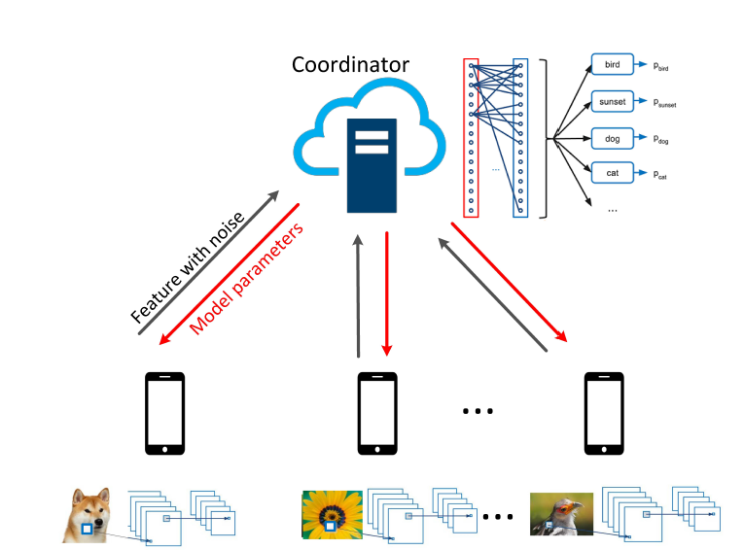
Partitioned CNN Training
participant
coordinator
Participant trains conv layers; coordinator trains dense layers
Only features (less data volume) and labels are transmitted
Participants send features in batches
Training loss is fed back to all participants that will update and maintain identical conv layers
Image credit: Towardsdatascience.com

Slide 10
Differential Privacy (DP)
An information-theoretic privacy definition
A randomized algorithm A gives ε-DP, if for all adjacent datasets D₁ and D₂ differing on at most one element:
When ε is very small, i.e., A(D₁) and A(D₂) are nearly indistinguishable
ε-DP for features sent to coordinator
Quantifiable indistinguishability of features yielded by the edge devices against the coordinator

Slide 11
DP Implementation
Laplace mechanism [Dwork et al]
n_{i} is drawn from Lap(S(F)/ε)
Global sensitivity
Difficult to determine global sensitivity after conv layers
Depends on data and conv layer parameters

Slide 12
Batch Normalization (BN)
BN is often used to avoid gradient exploding and vanishing problems
Normalize every batch of outputs from a layer
X_{i,j,k} denotes the pixel value at (i, j) of the k^{th} output in a batch (batch size = N)

Slide 13
Global Sensitivity & DP-CNN
Cauchy-Schwarz
inequality
participant
coordinator
Global sensitivity
conv layers
BN
noisification
dense layers
Internet

Slide 14
Outline
Motivation & Related Work
Objective & Approach
Evaluation
Conclusion

Slide 15
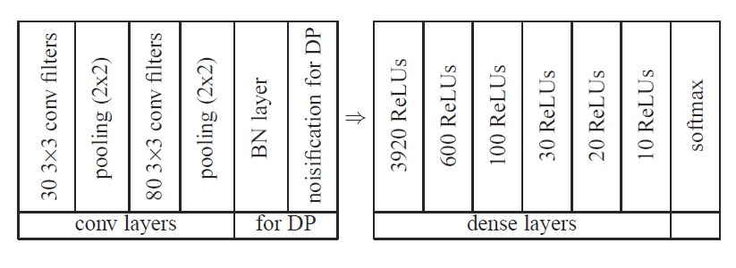
Performance Evaluation
MNIST dataset
Partitioned DP-CNN

Slide 16
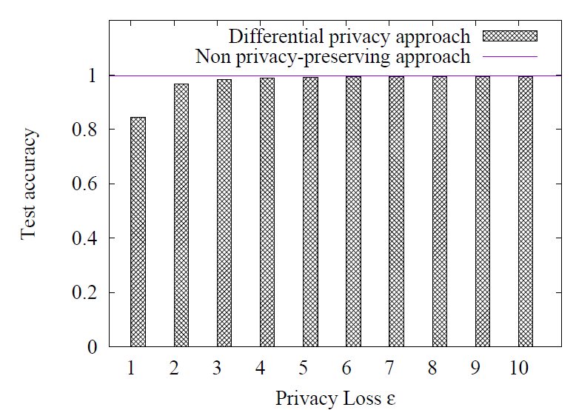
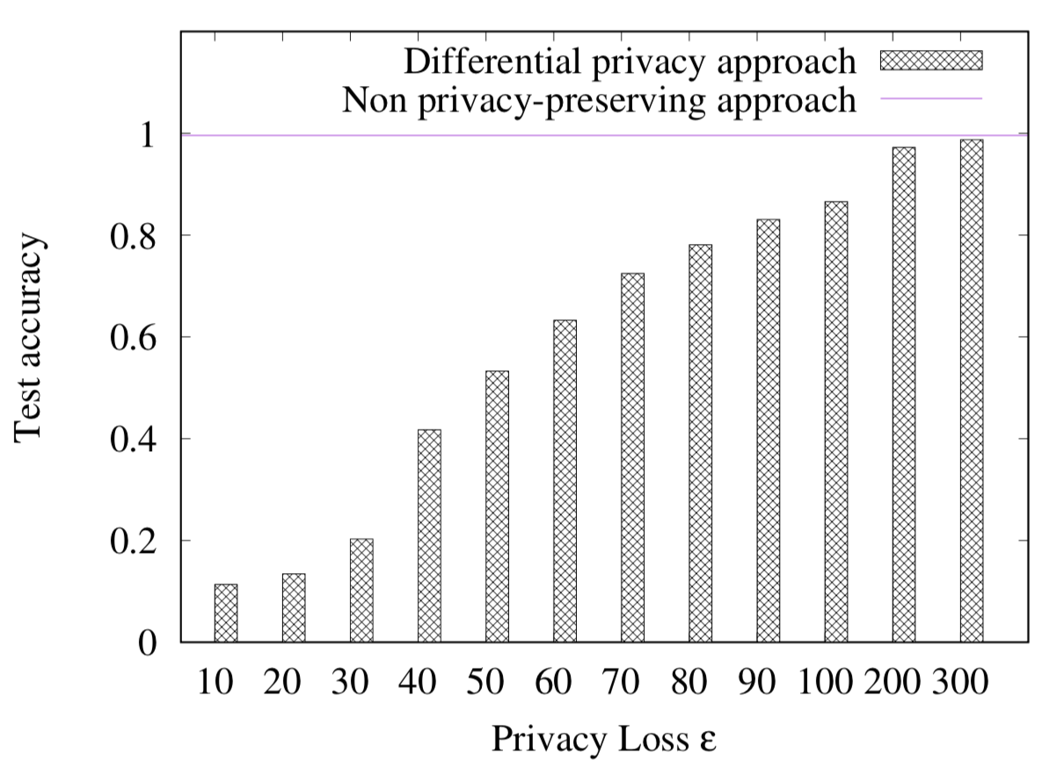
Impact of DP Noises
3% accuracy loss
DP noises added to features
DP noises added to raw data

Slide 17
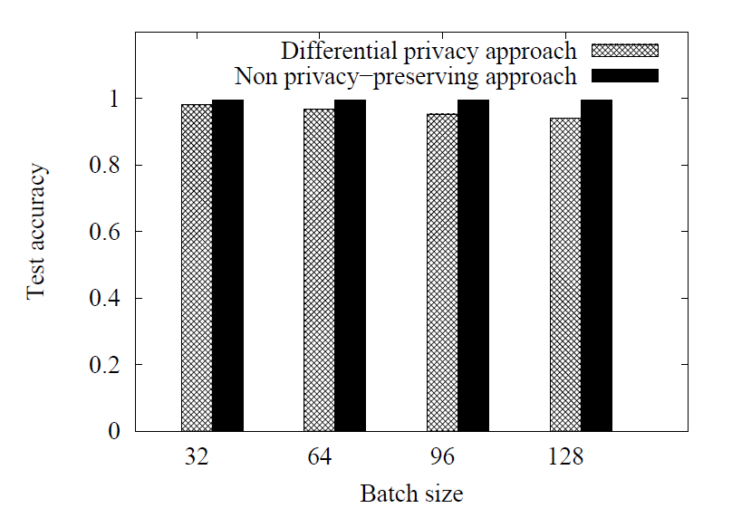
Impact of Batch Size
$$n_{i}\sim Lap\left(\frac{2\sqrt{N−1}}{ε}\right)$$
(ε = 2)
CNN with BN but no DP
0.2% accuracy loss when N is from 32 to 128
Partitioned DP-CNN
Large batch size: large DP noise
4.1% accuracy loss when N is from 32 to 128
Smaller batch size desired, but more frequent communications and more overhead

Slide 18
Conclusion
Collaborative learning for IoT edge devices
Trains different stages of a CNN at the edge devices and the cloud coordinator
Adds noises for preserving DP of features
Partitioned DP-CNN has 3% classification accuracy drop when $ε$ is down to 2

